Slide 1
Presentation
on
Loan Approval
Presented by Ankit Gochhayat
Guided by Mrs.Ritu Maity

Slide 2
Loan Approval Process with Eligibility
1.Loan Application Form filled by an applicant.
2.Hands form to bank.
3.Credit Score and Loan Application form verification by bank. (Low Credit Score leads to the rejection of loan.)
4.Eligibility Criteria for loan - High Credit Score
Basic Documentation Check. (Non-eligibility leads to rejection of loan . )
-
01

Slide 3
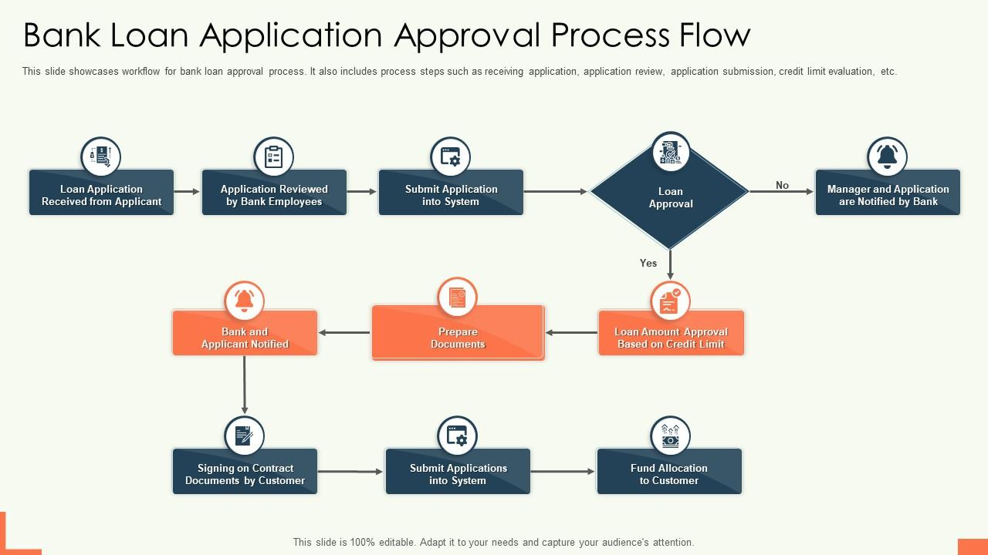
02

Slide 4
Ideation process
From different attributes such as
age , occupation , income , credit income we have to find loan status
03

Slide 5
Advantages
Analysing the people of different occupation which have applied for loan and which loan has approved or denied.
04

Slide 6
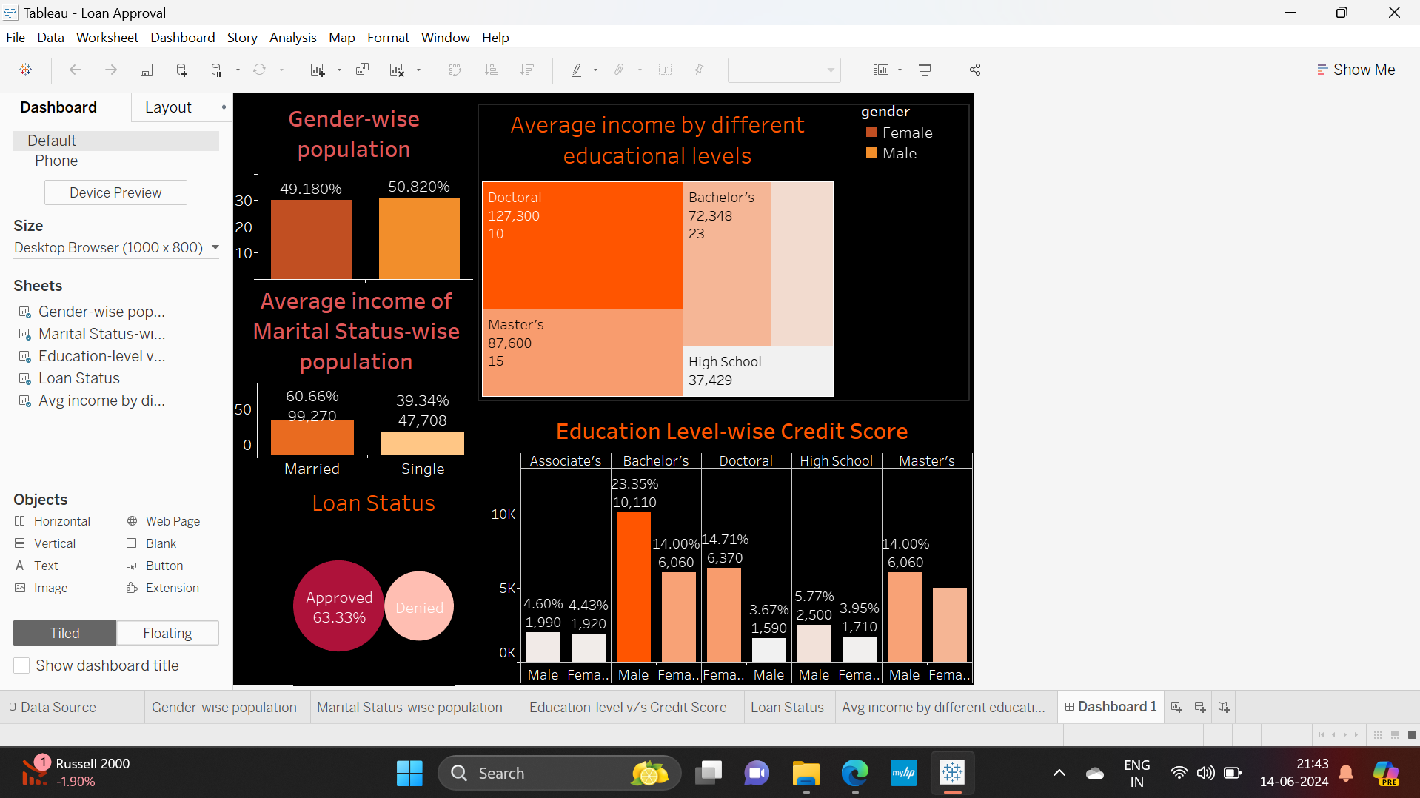
05

Slide 7
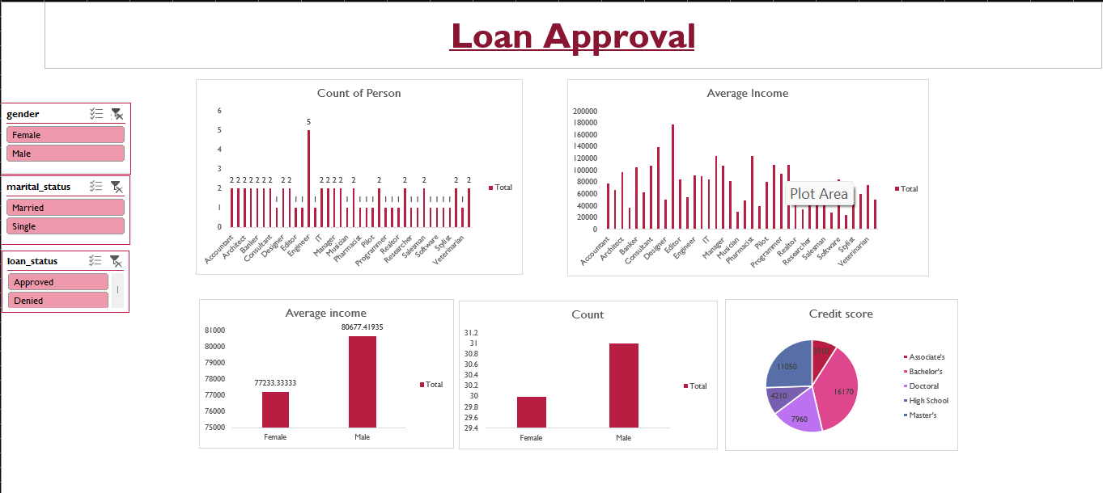
06

Slide 8
Thank You

